Slide 1
WHAM
Weighted Histogram Analysis Method
Problem:
  When simulations provide insufficient results over an entire region
Solution:
  Run biased simulations
  Remove bias and combine simulation results to give results over entire region

Slide 2
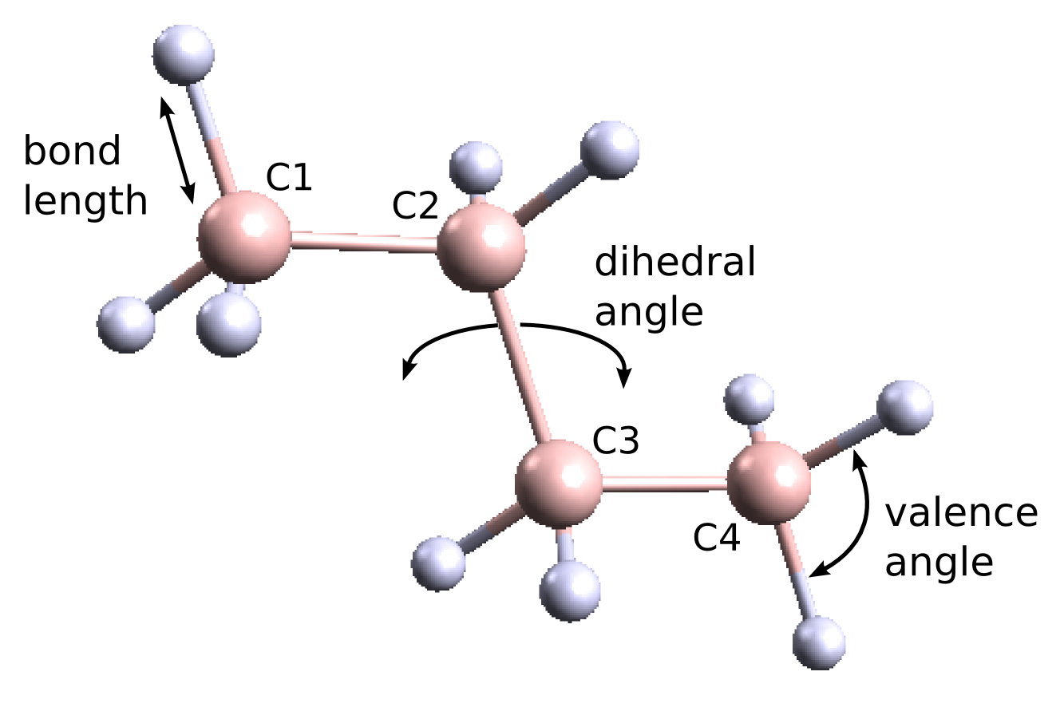
Butane - Lighter Gas
Want to measure the energy (PMF) as a function of dihedral angle

Slide 3
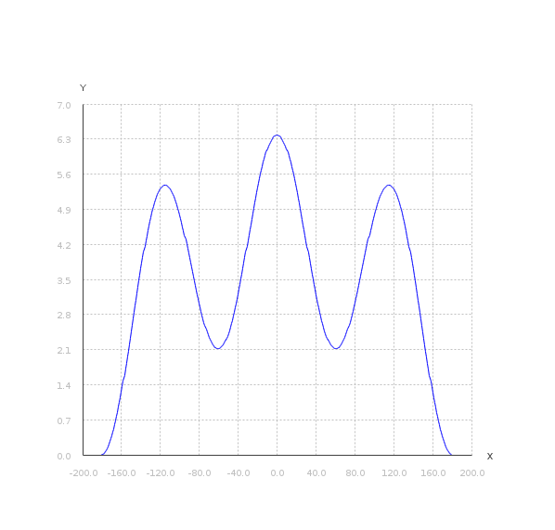
Butane - PMF
Unknown - Helps explain reactivity
Can be measured with Molecular Dynamics (MD) Simulations
Molecules favour regions of low energy
PMF
Dihedral Angel

Slide 4
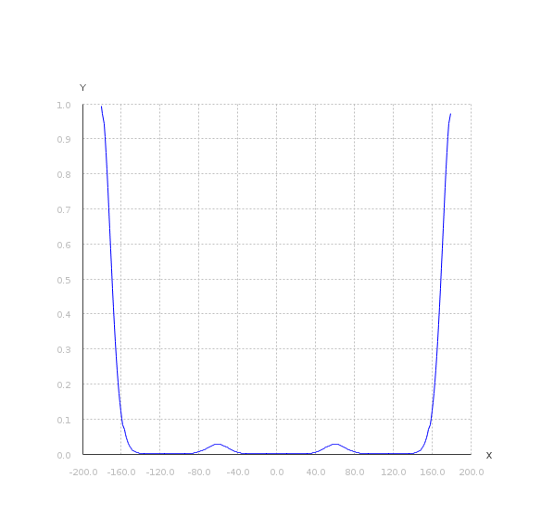

PMF and Probability
High energy <=> Low Sampling Probability
Probability
Dihedral Angel

Slide 5
Umbrella Sampling
Add an energy constraint to the MD simulation
Constraint biases the simulation to run around a chosen angle

Slide 6
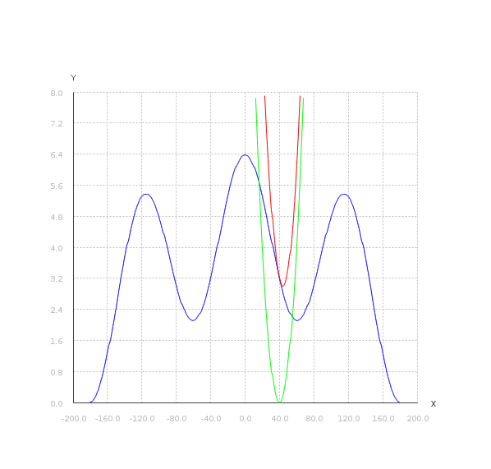
Umbrella Sampling
Adding the constraint at 40° biases simulation to red line
PMF
Dihedral Angel

Slide 7
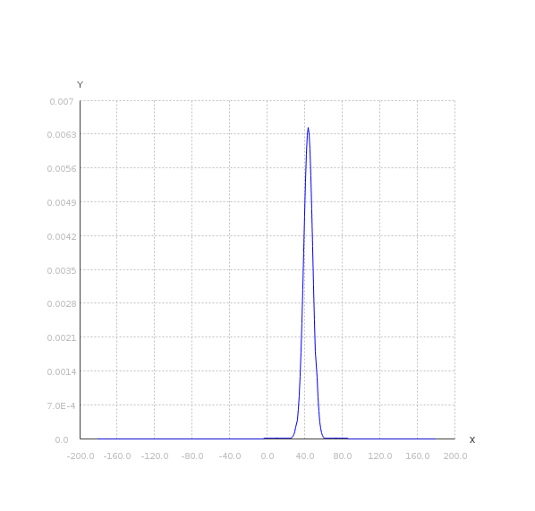
Umbrella Sampling
MD Sampling Probability at 40°
Probability
Dihedral Angel

Slide 8
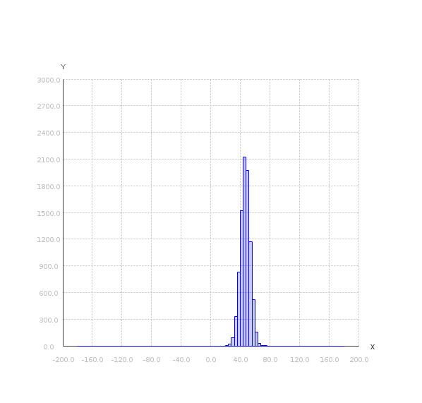
Umbrella Sampling
Samples at 40°
No. of
Samples
Dihedral Angel

Slide 9
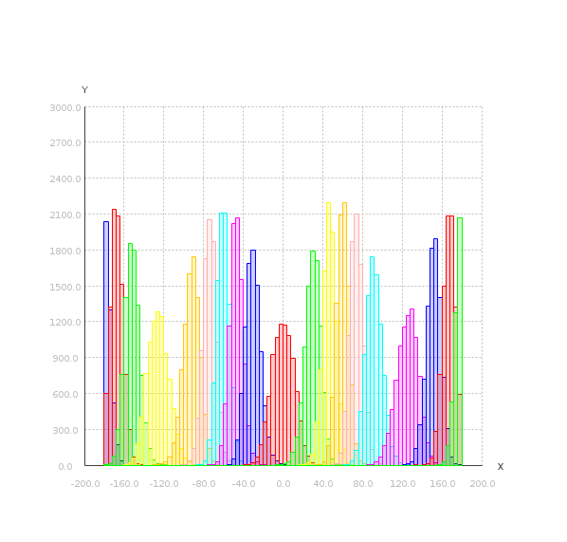
Umbrella Sampling
Do this every 20 degrees
No. of
Samples
Dihedral Angel

Slide 10
WHAM
Values from simulations
  Number of samples per bin for all histograms
  Number of samples per histogram
  Distribution bias applied

Slide 11
WHAM
Puts all the results back together
  Unknowns P and f
  Start with all f = 1
  Work out P
  Work out f
  Stop when difference f < 0.001
  You are left with P
  With P we can get PMF

Slide 12
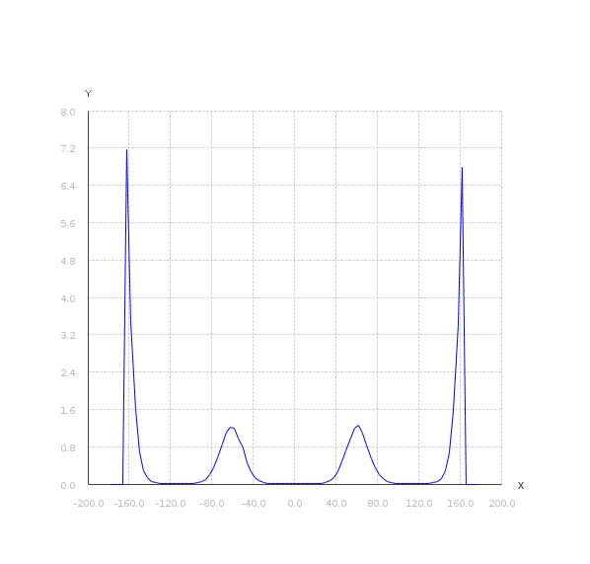
WHAM
Final Probability (P)
Probability
Dihedral Angel

Slide 13
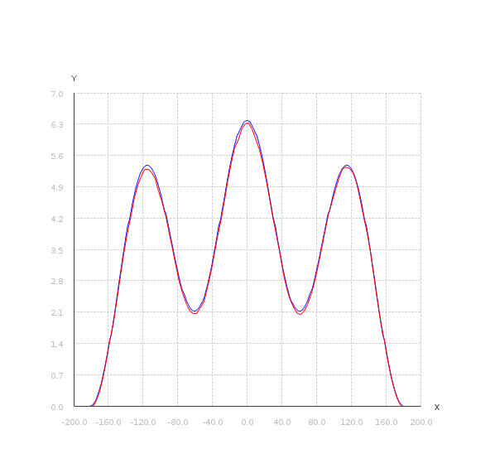

WHAM
Final PMF (red line)
PMF
Dihedral Angel

Slide 14
WHAM
The approach
  Generate test data
  Develop WHAM implementations
    CPU
    GPU
  Validate
  Measure speed up against problem size

Slide 15
Test Data
MD simulations are a dark art
Test Harness
    Generate samples from known reference PMF
    Validate the WHAM generated PMF against known
This is artificial :
(2*(cos((6.1*pi*x)/360)
-1.2*(x/180)*(x/180))+4.38)

Slide 16

Generating Samples
Monte Carlo with Sampling Probability at 40°
Probability
Dihedral Angel

Slide 17
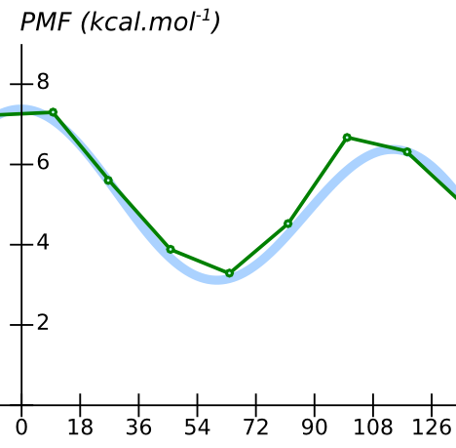

Validation
Use Root Mean Square Deviation
    Known Reference PMF
      against
    WHAM generated PMF

Slide 18
WHAM
Implementations
  Wrote a sequential version in Java
  Then parallel versions
    Java Multi Threading
    Java Fork Join Framework
    3 - 4x speed on 8 CPU's up for small dataset

Slide 19
WHAM
Main optimization
  Pre-compute and cache static values

Slide 20
WHAM
Implementations
  Wrote an optimised sequential version in C++
  Then parallel version on GPGPU
    Cached values only transferred once
    Two kernels for block synchronization between equations
    Mixed computation on GPU and CPU
    Multi-dimensional support by flattening histograms

Slide 21
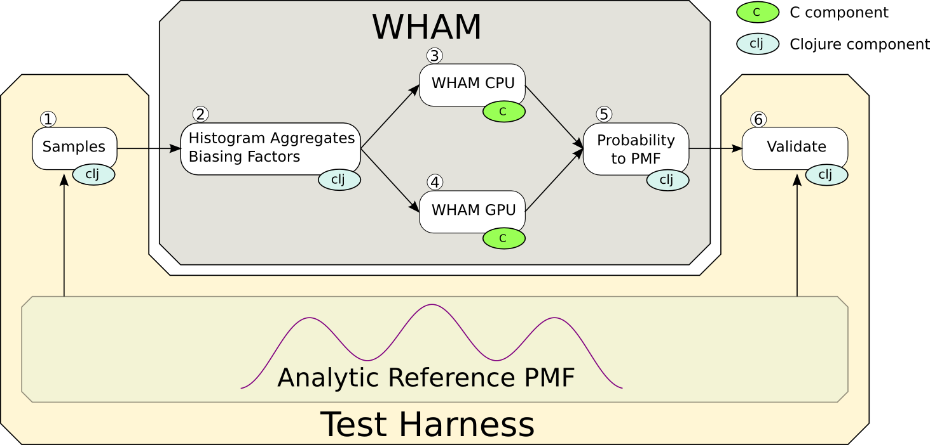
WHAM
Entire System

Slide 22
WHAM
Clojure benefits
  Simulation config defined as code
  Easy function composition and currying
  Functions easily extended to n-dimensions
  Availability of NDArray implementation.

Slide 23
WHAM
Results
  Can vary number of dimensions, histograms and bins.
  20 2D test cases created
  Best result:
    2D test case
    61 x 61 histograms and 180 x 180 bins
    120M elements
    19x speed-up

Slide 24
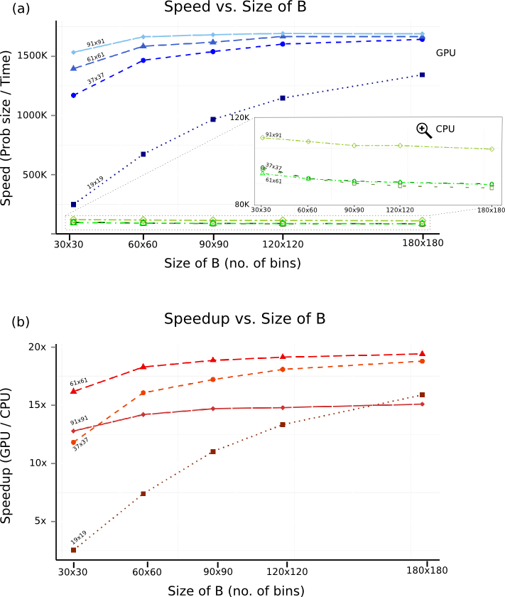
WHAM

Slide 25
WHAM

Slide 26
Okay bye

